Slide 1
CS 478 – Tools for Machine Learning and Data Mining
Data Understanding

Slide 2
Data Collection and Handling
Prerequisites to Machine Learning and Data Mining
Issues:
  Visuliazation
  Bias
  Twyman’s Law
  Simpson’s Paradox

Slide 3
Bird’s-eye View

Slide 4
Data Relevance
What data is available for the task?
Is this data relevant?
Is additional relevant data available?
How much historical data is available?
Who are the data experts?

Slide 5
Data Quantity
Number of instances (records)
  Rule of thumb: 5,000+ desired
  If less, results are less reliable; use special methods (boosting, …)
Number of attributes (fields)
  Rule of thumb: for each field, 10+ instances
  If more fields, use feature reduction/selection
Number of targets
  Rule of thumb: 100+ for each class
  if very unbalanced, use stratified sampling

Slide 6
Data Acquisition
Data can be in DBMS
  ODBC, JDBC protocols
Data in a flat file
  Fixed-column format
  Delimited format: tab, CSV , other
  Attention: Convert field delimiters inside strings
Verify the number of fields before and after

Slide 7
Metadata
Attribute types:
  binary, nominal (categorical), ordinal, numeric, …
Attribute roles:
  input: inputs for modeling
  target: output
  id/auxiliary: keep, but do not use for modeling
  ignore: do not use for modeling
  weight: instance weight
  …
Attribute descriptions

Slide 8
Attribute Types
Nominal
  E.g., eye color={brown, blue, …}
  No relation, ordering, or distance implied
  Only equality tests
Ordinal
  E.g., grade={k, 1, …, 12}, height = {tall > med > short}
  Order BUT no distance
Continuous (numeric)
  Interval quantities – integer (e.g., year)
    Difference makes sense, not sum/product
  Ratio quantities – real (e.g., length)
    Measurement scheme defines 0 point, all operations allowed

Slide 9
Take Home Message
Be thorough
Use all available sources of information
Ensure you have sufficient, relevant data before you go further
Consult domain experts

Slide 10
Visualization
(Adapted from G. Piatetsky-Shapiro)

Slide 11
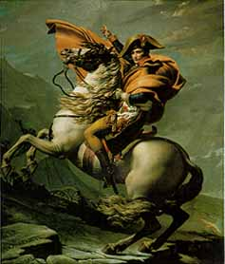
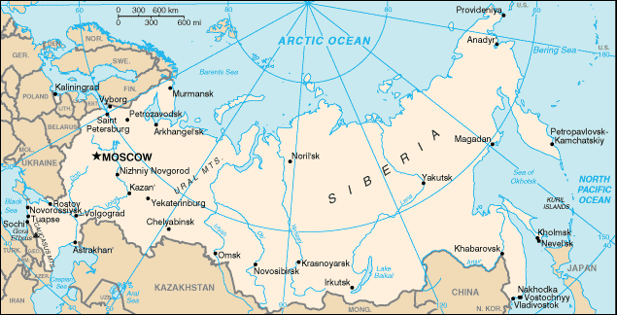
Napoleon Invasion of Russia, 1812
Napoleon

Slide 12
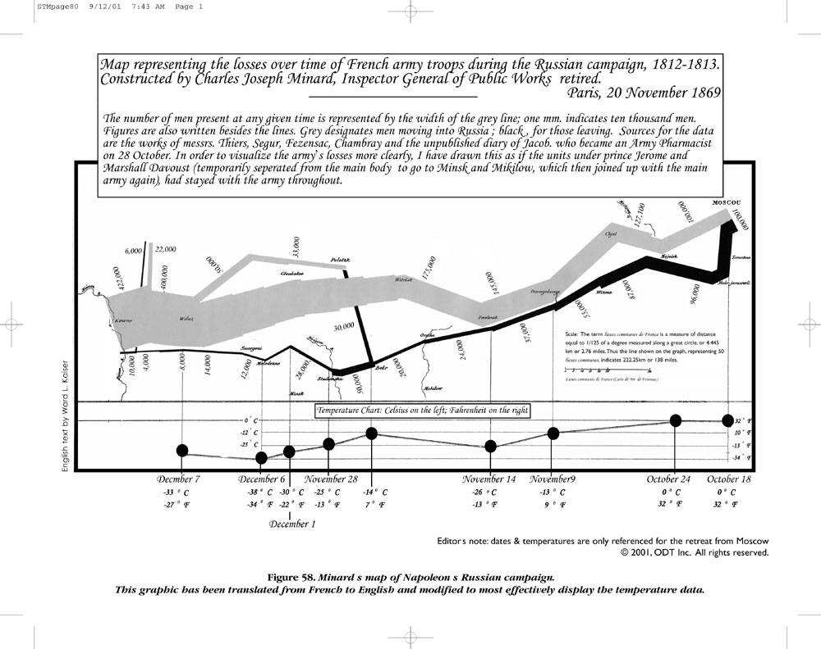
© www.odt.org , from http://www.odt.org/Pictures/minard.jpg, used by permission

Slide 13
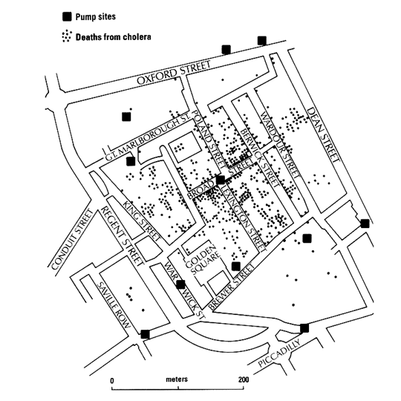
Snow’s Cholera Map, 1855

Slide 14
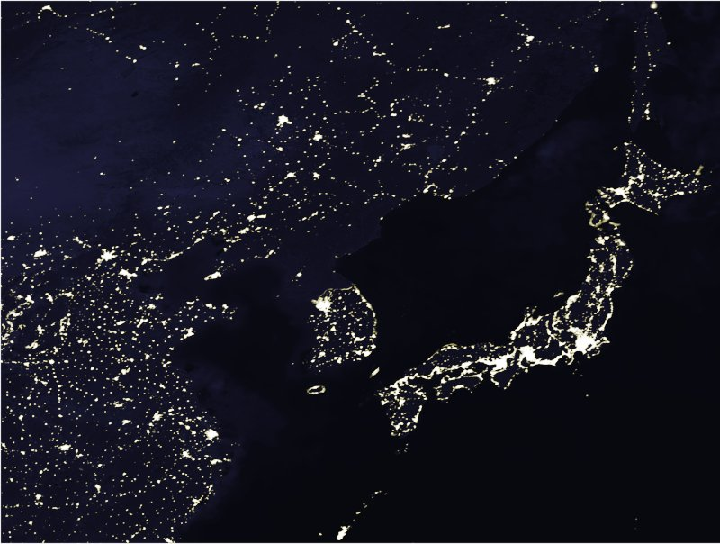
Far East Asia at Night

Slide 15

Korea at Night
North Korea
Notice how dark
it is !
Seoul,
South Korea

Slide 16
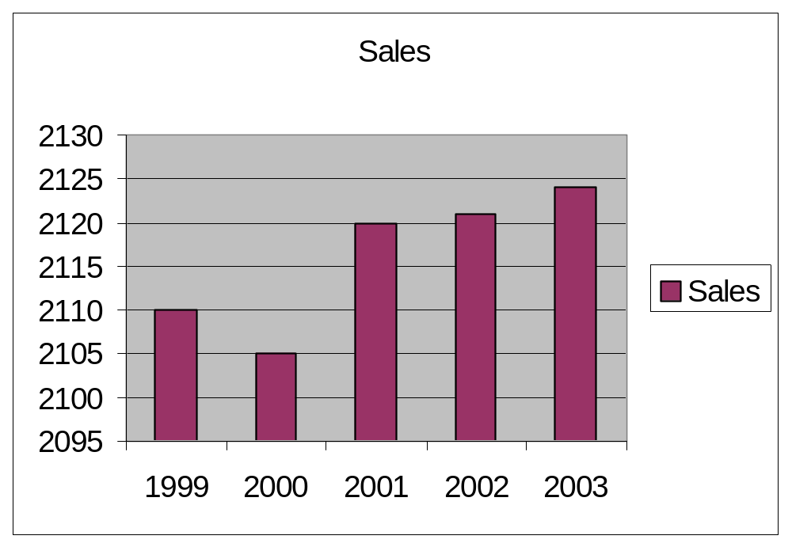
Bad Visualization
Year | Sales
1999 | 2110
2000 | 2105
2001 | 2120
2002 | 2121
2003 | 2124
Y-Axis scale gives WRONG
impression of big change

Slide 17
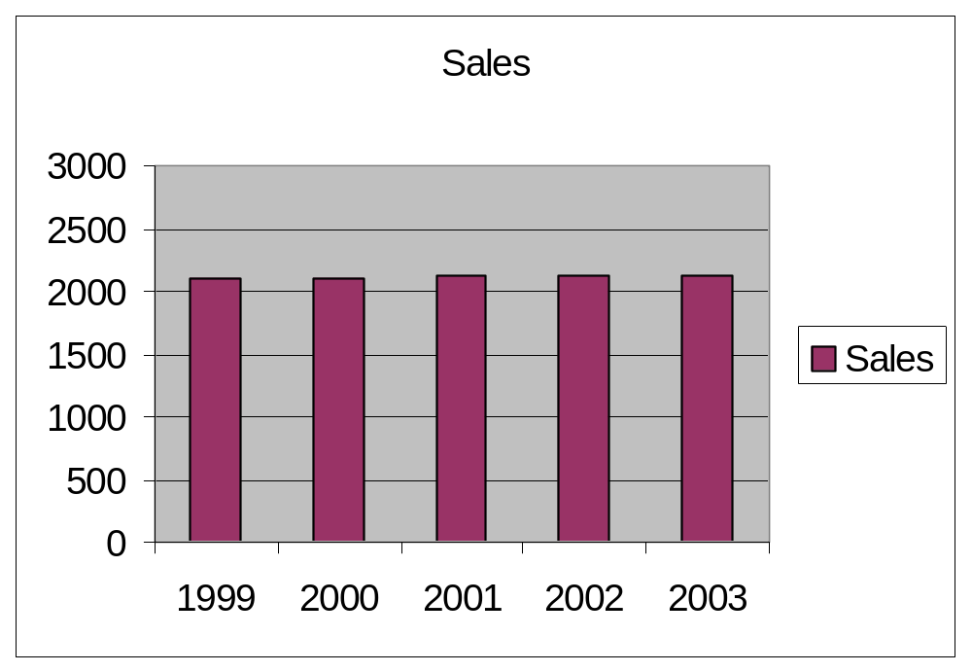
Better Visualization
Year | Sales
1999 | 2110
2000 | 2105
2001 | 2120
2002 | 2121
2003 | 2124
Axis from 0 to 2000 scale gives
CORRECT impression of small change

Slide 18
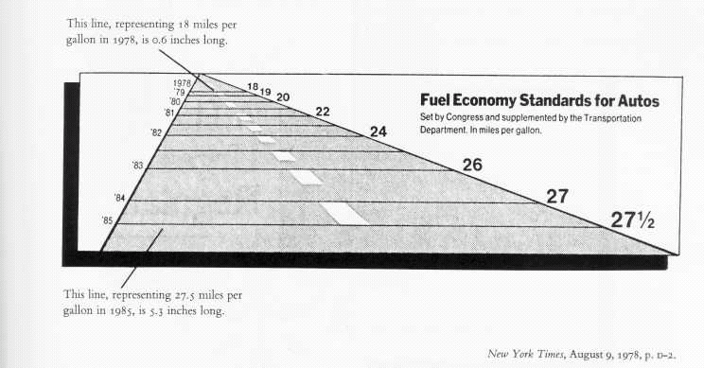
Another Bad Visualization
Lie Factor=14.8
(E.R. Tufte, “The Visual Display of Quantitative Information”, 2nd edition)

Slide 19
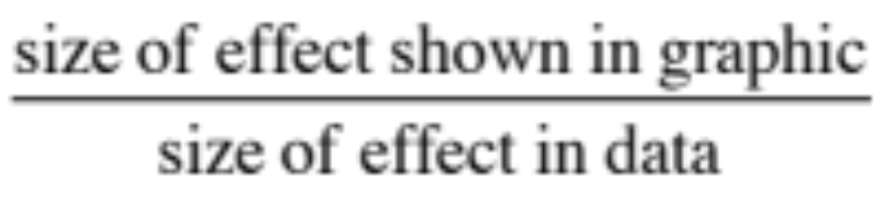
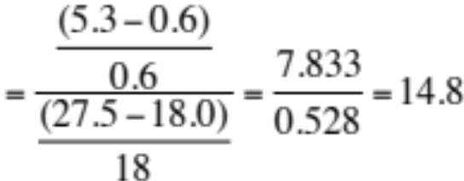
Lie Factor
For the fuel economy graph
Tufte’s requirement: 0.95<Lie Factor<1.05
(E.R. Tufte, “The Visual Display of Quantitative Information”, 2nd edition)

Slide 20
Visualization Methods
Visualizing in 1-D, 2-D and 3-D
  Well-known visualization methods (box plots, histograms, scatter plots, etc.)
Visualizing more dimensions
  Scatterplot matrix
  Parallel coordinates
  Other ideas

Slide 21
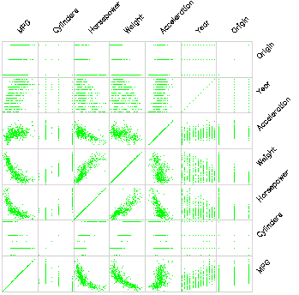
Scatterplot Matrix
Represent each possible
pair of variables in their
own 2-D scatterplot
(car data)
Q: Useful for what?
A: linear correlations
(e.g. horsepower & weight)
Q: Misses what?
A: multivariate effects

Slide 22
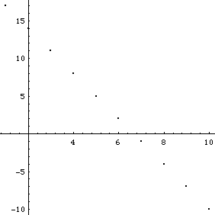
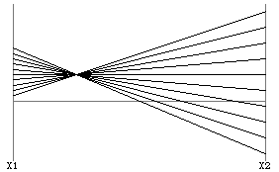
Parallel Coordinates
Encode variables along a horizontal row
Vertical line specifies values
Same dataset in parallel coordinates
Dataset in a Cartesian coordinates
Invented by
Alfred Inselberg
while at IBM, 1985

Slide 23
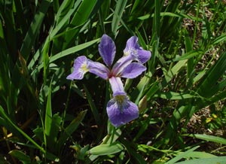
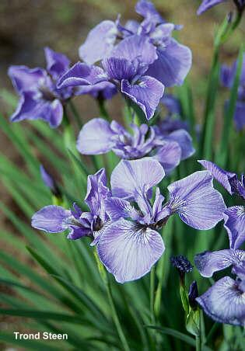
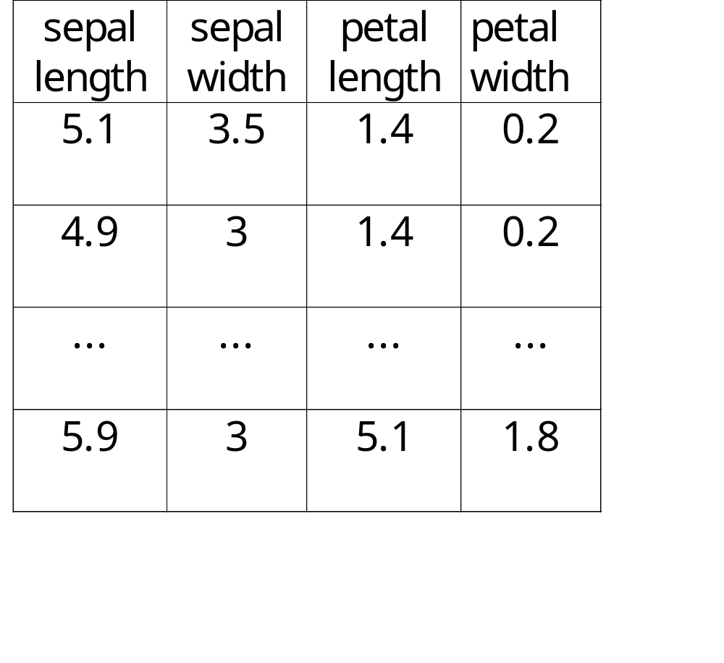
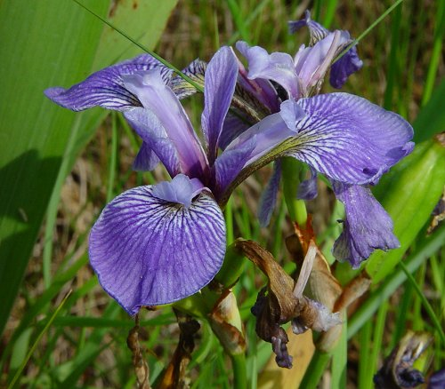
Example: Visualizing Iris Data
Iris versicolor
Iris setosa
Iris virginica

Slide 24
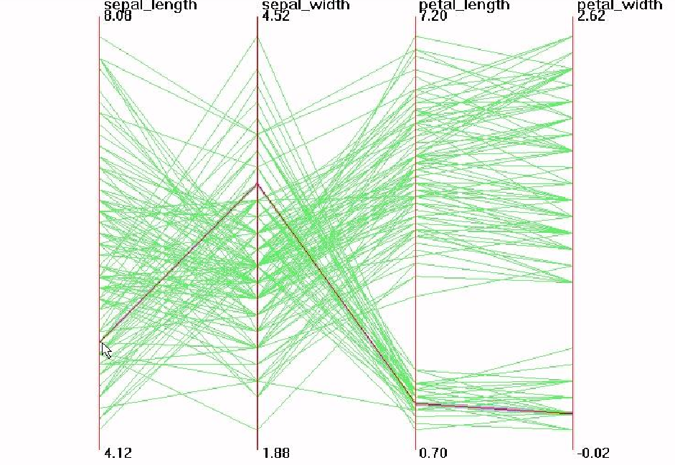

Parallel Visualization of Iris data
3.5
5.1
1.4
0.2

Slide 25
Parallel Coordinates Summary
Each data point is a line
Similar points correspond to similar lines
Lines crossing over correspond to negatively correlated attributes
Interactive exploration and clustering
Problems: order of axes, limit to about 20 dimensions

Slide 26
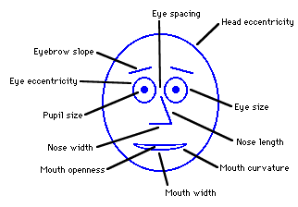
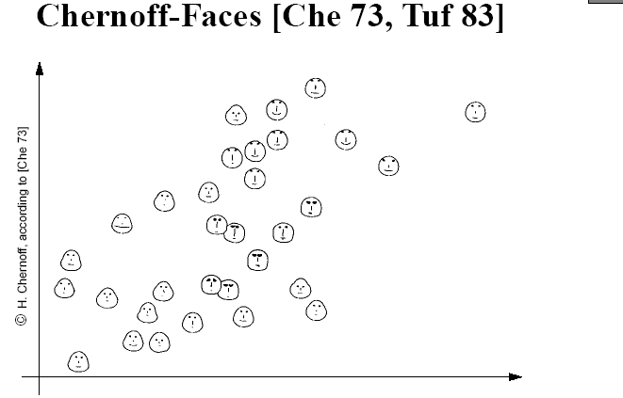
Chernoff Faces
Encode different variables’ values in characteristics
of human face
http://www.cs.uchicago.edu/~wiseman/chernoff/
http://hesketh.com/schampeo/projects/Faces/chernoff.html

Slide 27
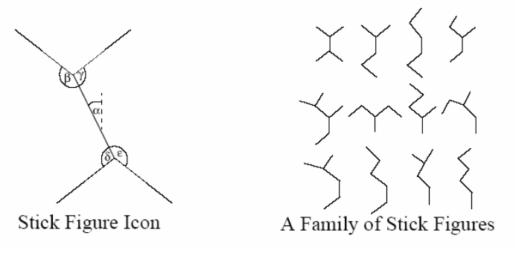
Stick Figures
Two variables mapped to X, Y axes
Other variables mapped to limb lengths and angles

Slide 28
Take Home Message
Many methods
Aim for graphical excellence
  Tufte’s Principle:
    Give the viewer the greatest number of ideas, in the shortest time, with the least ink in the smallest space
    AND Tell the truth about the data!
Free and open-source software
  Ggobi, Xmdv, Others (see www.kdnuggets.com/software/visualization.html)

Slide 29
Bias

Slide 30
Sources of Bias in Data
Selection/sampling bias
  E.g., collect data from BYU students on college drinking
Sponsor’s bias
  E.g., PLoS Medicine article: 111 studies of soft drinks, juice, and milk that cited funding sources (22% all industry, 47% no industry, 32% mixed). The proportion with unfavorable [to industry] conclusions was 0% for all industry funding versus 37% for no industry funding
Publication bias
  E.g., Positive results more likely to be published
Data manipulation bias
  E.g., Imputation (replacing missing values by mean in skewed data)
  E.g., Record selection (removing records with missing values)

Slide 31
Impact on Learning
If there is bias in the data collection or handling processes
  You are likely to learn the bias
  Conclusions become useless/tainted
If there is no bias
  What you learn will be “valid”
Note: Recall that, unlike data, learning should be biased

Slide 32
Take Home Message
Uncover existing data biases and do your best to remove them
Do not add new sources of data bias, maliciously or inadvertently

Slide 33
Twyman’s Law

Slide 34
Cool Findings
5% of our customers were born in the same day (including year)
There is a sales decline on April 2nd, 2006 on all US e-commerce sites
Customers willing to receive emails are also heavy spenders

Slide 35
What Is Happening?
11/11/11 is the easiest way to satisfy the mandatory birth date field!
Due to daylight saving starting, the hour from 1AM to 2AM does not exist and hence nothing will be sold during that period!
The default value at registration time is “Accept Emails”!

Slide 36
Take Home Message
Cautious optimism
Twyman’s Law: Any statistic that appears interesting is almost certainly a mistake
Many “amazing” discoveries are the result of some (not always readily apparent) business process
Validate all discoveries in different ways

Slide 37
Simpson’s Paradox

Slide 38
“Weird”Findings
Kidney stone treatment: overall treatment B is better; when split by stone size (large/small), treatment A is better
Gender bias at UC Berkeley: overall, a higher percentage of males than females are accepted; when split by departments, the situation is reversed
Purchase channel: overall, multi-channel customers spend more than single-channel customers; when split by number of purchases per customer, the opposite is true
Email campaign performance: overall, revenue per email is decreasing; when split by subscriber type (engaged/others), productivity per email campaign is increasing
Presidential election: overall, candidate X’s tally of individual votes is highest; when split by states, candidate Y wins the election

Slide 39
What Is Happening?
Kidney stone treatment: neither treatment worked well against large stone, but treatment A was heavily tested on those
Gender bias at UC Berkeley: departments differed in their acceptance rates and female students applied more to departments were such rates were lower
Purchase channel: customers that visited often spent more on average and multi-channel customers visited more
Email campaign: file mix issue, number of disinterested prospects grows faster than number of engaged customers
Presidential election: winner-take-all favors large states

Slide 40
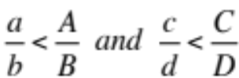
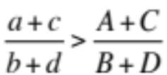
Take Home Message
These effects are due to confounding variables
Combining segments ➔weighted average
    if it is possible that
Lack of awareness of the phenomenon may lead to mistaken/misleading conclusions
  Must be careful not to infer causality from what are only correlations
  Only sure cure/gold standard (for causality inference): controlled experiments
    Careful with randomization
    Not always desirable/possible (e.g., parachutes)
Confounding variables may not be among the ones we are collecting (latent/hidden)
Watch out for them!

